Slide 1

A Presentation brought to you by the
Bear ye one another's burdens, and so fulfil the law of Christ.
(Galatians 6:2)

Slide 2
Website:acncounseling.org

Slide 3
Presentation
“Addiction: Are you and your loved one’s in danger? Bondage or Freedom?”

Slide 4
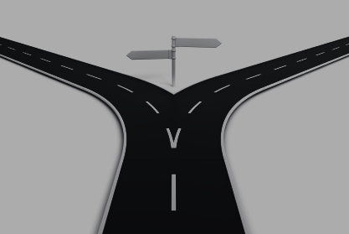
Awareness and Prevention
vs
Recovery

Slide 5
Focus: Awareness and Prevention
Addiction…? Who…? Me…?
Definition of addiction
Biblical view of addiction
Types of addiction
“Testing…”
Physical effects on our body

Slide 6
Focus: Awareness and Prevention
Physical dangers
Why we use
What causes addiction?:
  Bio-psycho-social-spiritual
Warning signs
What bondage looks like
What freedom looks like

Slide 7

So what’s the big deal…?

Slide 8
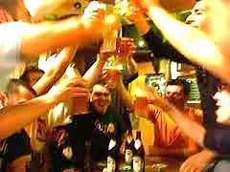
“You need alcohol to have fun…”

Slide 9
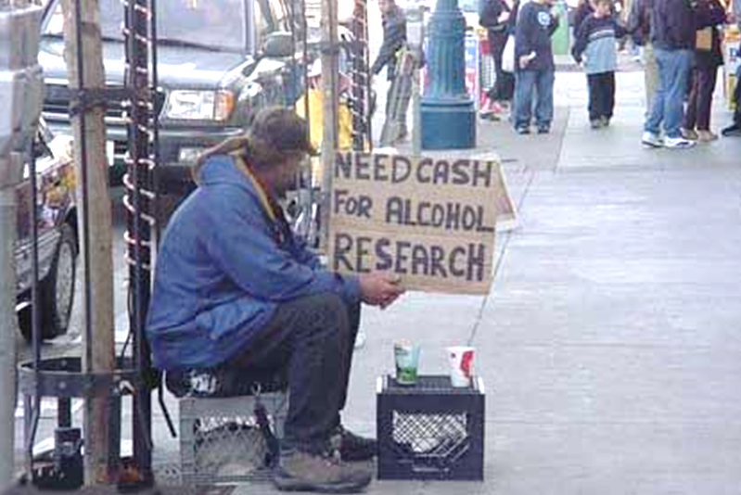
“Only “others” have problems…”

Slide 10
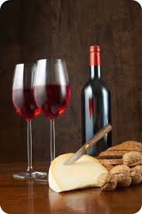
“I only drink
occasionally…”

Slide 11
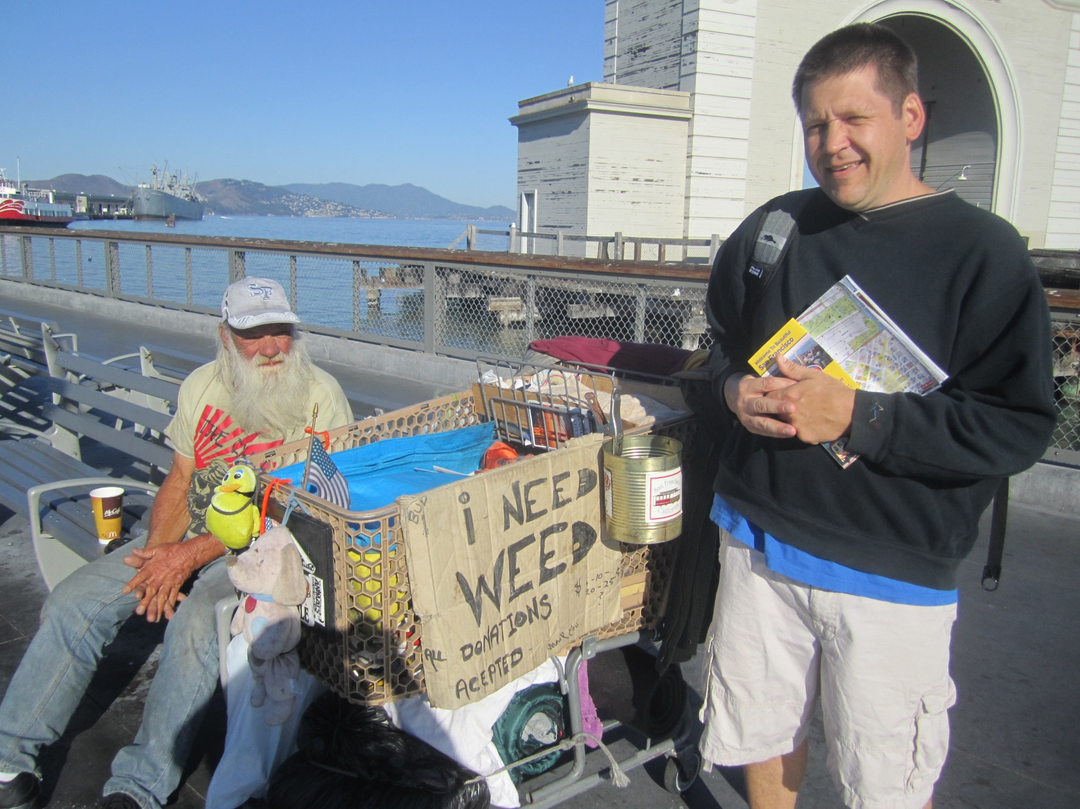
“…no thanks…”

Slide 12
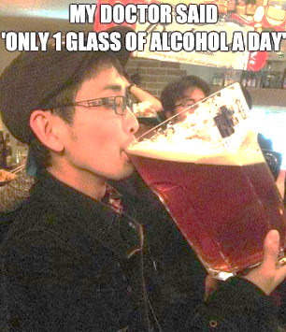
“…I’m fine…
…really”

Slide 13
So what is the big deal…?

Slide 14
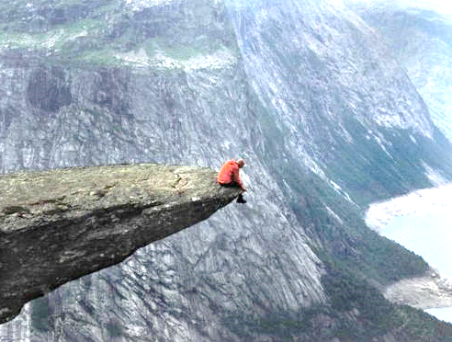
Addiction…are you at risk….?

Slide 15
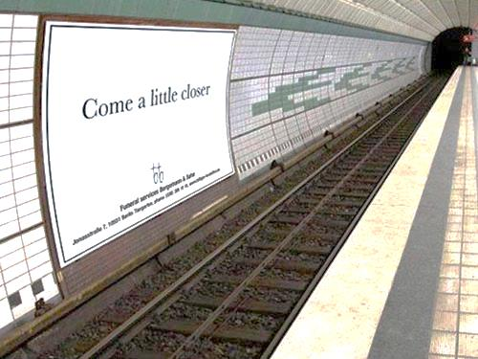
Addiction…are you at risk….?

Slide 16
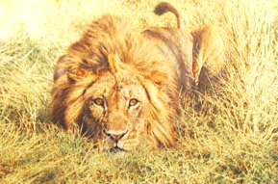
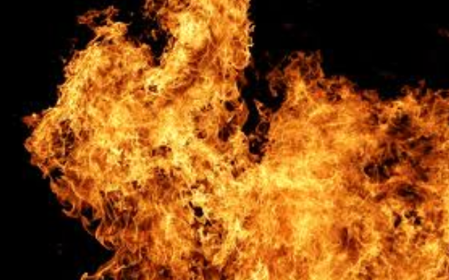
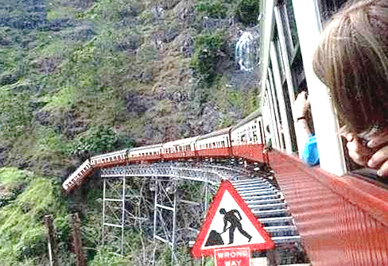
Addiction…are
you at risk….?

Slide 17
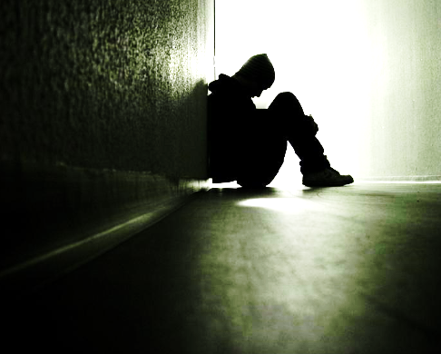
Addiction…what is it…?

Slide 18
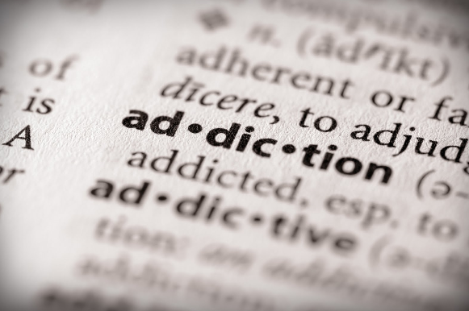

Slide 19
Addiction: What is it?
      * Salience – “Who is in control?”
      * Mood modification – “I want that feeling”
      * Tolerance – “More….is less”
      * Withdrawal – “Stopping is a pain…”
      * Conflict – “…so much suffering…”
      * Relapse – “…can’t stay stopped…”

Slide 20
Addiction: What is it?
      * Salience – “Who is in control?”
      * Mood modification – “I want that feeling”
      * Tolerance – “More….is less”
      * Withdrawal – “Stopping is a pain…”
      * Conflict – “…so much suffering…”
      * Relapse – “…can’t stay stopped…”

Slide 21
Addiction: What is it?
      * Salience – “Who is in control?”
      * Mood modification – “I want that feeling”
      * Tolerance – “More….is less”
      * Withdrawal – “Stopping is a pain…”
      * Conflict – “…so much suffering…”
      * Relapse – “…can’t stay stopped…”

Slide 22
Addiction: What is it?
      * Salience – “Who is in control?”
      * Mood modification – “I want that feeling”
      * Tolerance – “More….is less”
      * Withdrawal – “Stopping is a pain…”
      * Conflict – “…so much suffering…”
      * Relapse – “…can’t stay stopped…”

Slide 23
Addiction: What is it?
      * Salience – “Who is in control?”
      * Mood modification – “I want that feeling”
      * Tolerance – “More….is less”
      * Withdrawal – “Stopping is a pain…”
      * Conflict – “…so much suffering…”
      * Relapse – “…can’t stay stopped…”

Slide 24
Addiction: What is it?
      * Salience – “Who is in control?”
      * Mood modification – “I want that feeling”
      * Tolerance – “More….is less”
      * Withdrawal – “Stopping is a pain…”
      * Conflict – “…so much suffering…”
      * Relapse – “…can’t stay stopped…”

Slide 25
Addiction: What is it?
      * Salience – “Who is in control?”
      * Mood modification – “I want that feeling”
      * Tolerance – “More….is less”
      * Withdrawal – “Stopping is a pain…”
      * Conflict – “…so much suffering…”
      * Relapse – “…can’t stay stopped…”

Slide 26
SCRIPTURE
Galations 5: 19-21
“Now the works of the flesh are manifest, which are these; Adultery, fornication, uncleanness, lasciviousness, Idolatry … drunkenness, revellings, and such like… they which do such things shall not inherit the kingdom of God.”
Proverbs 23: 19-35
“Hear thou, my son, and be wise… Be not among winebibbers… For the drunkard and the glutton shall come to poverty… who hath sorrow… who hath babbling… who hath redness of eyes…They that tarry long at the wine... At the last it biteth like a serpent, and stingeth like an adder…Thine eyes shall behold strange women, and thine heart shall utter perverse things…when shall I awake? I will seek it yet again.”

Slide 27
SCRIPTURE
Galations 5: 19-21
“Now the works of the flesh are manifest, which are these; Adultery, fornication, uncleanness, lasciviousness, Idolatry … drunkenness, revellings, and such like… they which do such things shall not inherit the kingdom of God.”
Proverbs 23: 19-35
“Hear thou, my son, and be wise… Be not among winebibbers… For the drunkard and the glutton shall come to poverty… who hath sorrow… who hath babbling… who hath redness of eyes…They that tarry long at the wine... At the last it biteth like a serpent, and stingeth like an adder…Thine eyes shall behold strange women, and thine heart shall utter perverse things…when shall I awake? I will seek it yet again.”

Slide 28
Using the term “addiction”
does not excuse sin and accountability.
James 1: 13-15 “Let no man say when he is tempted, I am tempted of God: for God cannot be tempted with evil, neither tempteth he any man: But every man is tempted, when he is drawn away of his own lust, and enticed…”
Romans 6: 12-13 “Let not sin therefore reign in your mortal body, that ye should obey it in the lusts thereof. Neither yield ye your members as instruments of unrighteousness unto sin: but yield yourselves unto God, as those that are alive from the dead, and your members as instruments of righteousness unto God.”

Slide 29
Using the term “addiction”
does not excuse sin and accountability.
Roman 1: 28-31 “And even as they did not like to retain God in their knowledge, God gave them over to a reprobate mind, to do those things which are not convenient; Being filled with all unrighteousness, fornication, wickedness, covetousness, maliciousness; full of envy, murder, debate, deceit, malignity; whisperers, Backbiters, haters of God, despiteful, proud, boasters, inventors of evil things, disobedient to parents, without understanding, covenantbreakers, without natural affection, implacable, unmerciful:

Slide 30
Addictive Agents
          Alcohol
          Tobacco
          Marijuana
          Prescription drugs
          Inhalants
          Club Drugs
          Hallucinogens
          Metamphetamine
          Cocaine & Heroin

Slide 31
Behavioural Addiction
Pornography
Gambling
Co-dependency

Slide 32
Behavioural Addiction
Pornography
Gambling
Co-dependency

Slide 33
Behavioural Addiction
Pornography
Gambling
Co-dependency

Slide 34
Behavioural Addiction
Pornography
Gambling
Co-dependency

Slide 35
Others…

Slide 36

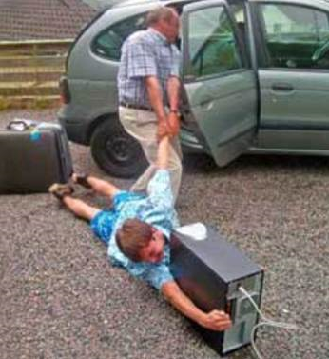


Slide 37
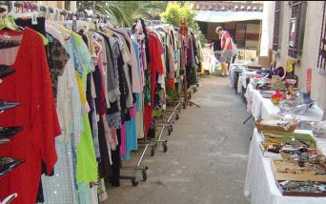
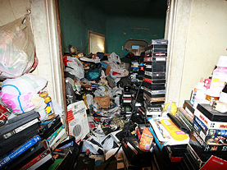
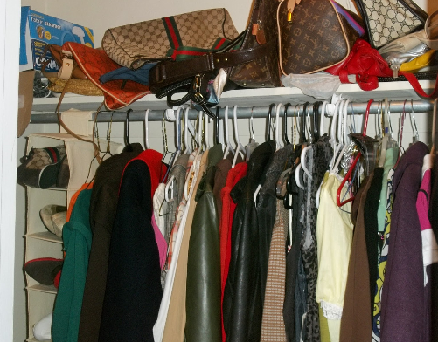

Slide 38
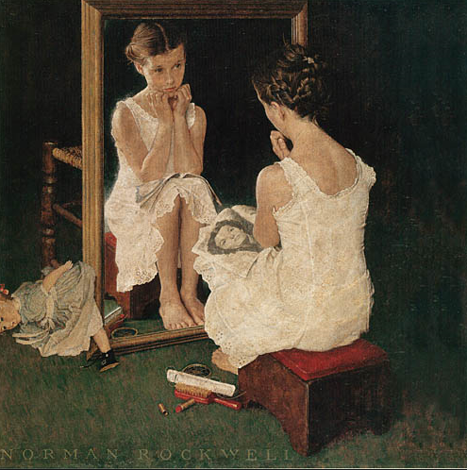


Slide 39


Slide 40
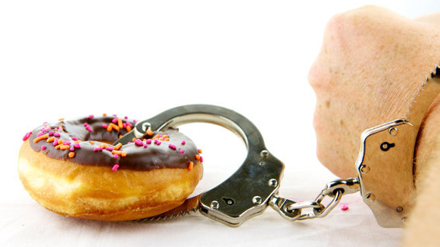
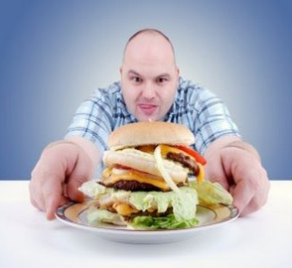
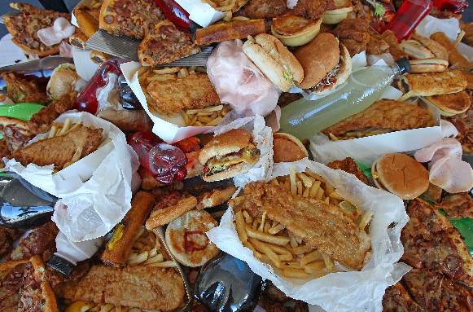

Slide 41
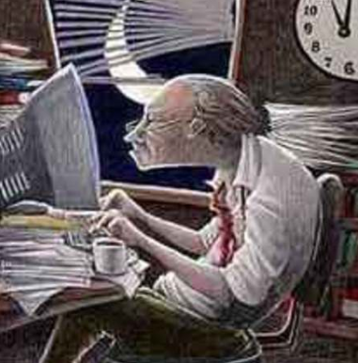
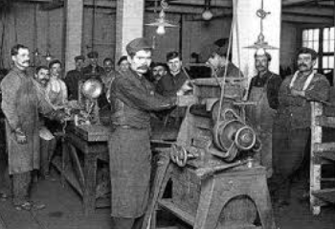

Slide 42
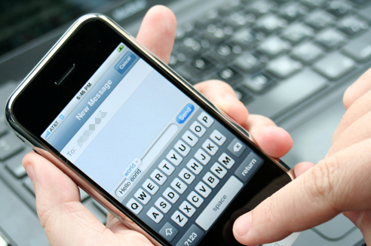
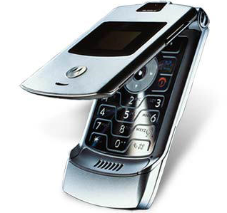

Slide 43
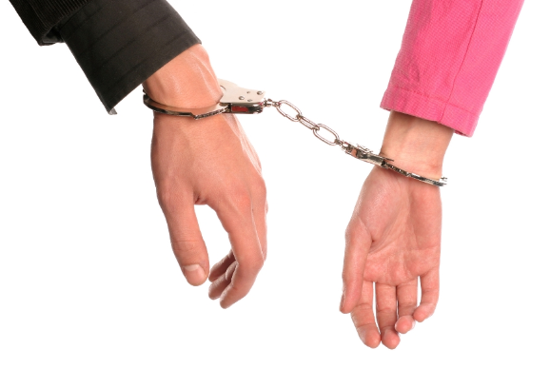
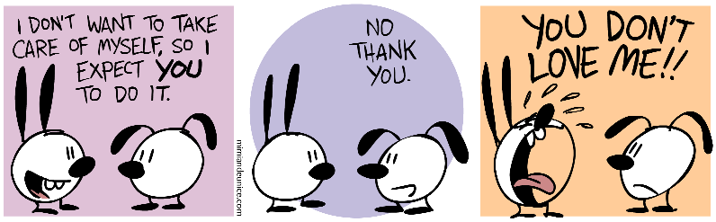

Slide 44
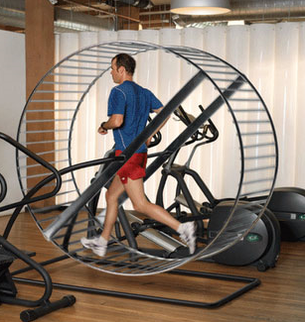


Slide 45
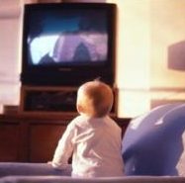
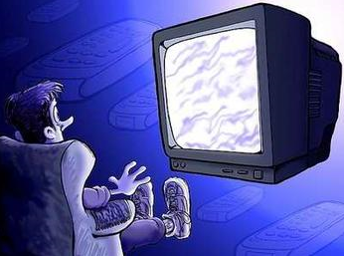
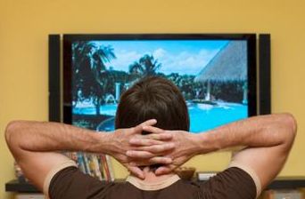

Slide 46
Internet
Video games
Social media (Facebook)
Television/Cable/Movies
Junk food
Sugar
Food
Work
Body Image
Exercise
Shopping
Relationships
Cell phone
Others…

Slide 47

Does this relate to ME or my LOVED ONE’S?

Slide 48
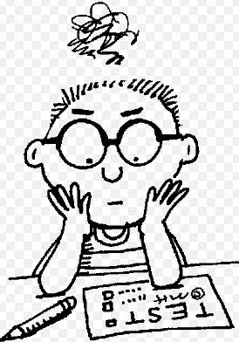
“TESTING 1 2 3…”

Slide 49
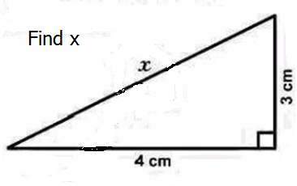
Practice Test

Slide 50
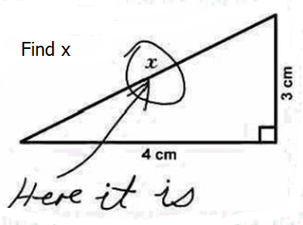
Practice Test

Slide 51
“TESTING 1 2 3….”
1. You spend a lot of time thinking about _________or plan use of_________.
Score:
Very rarely Rarely Sometimes Often Very Often

Slide 52
“TESTING 1 2 3….”
2. You feel an urge to use _________more and more.
Score:
Very rarely Rarely Sometimes Often Very Often

Slide 53
“TESTING 1 2 3….”
3. You use _________in order to forget about personal problems.
Score:
Very rarely Rarely Sometimes Often Very Often

Slide 54
“TESTING 1 2 3….”
4. You have tried to cut down on the use of _________ without success.
Score:
Very rarely Rarely Sometimes Often Very Often

Slide 55
“TESTING 1 2 3….”
5. You become restless or troubled if you are prohibited from using _________.
Score:
Very rarely Rarely Sometimes Often Very Often

Slide 56
“TESTING 1 2 3….”
6. You use _________ so much that it has had a negative impact on your life (relationship with God, family, studies, job, your thoughts, activities, etc)
Score:
Very rarely Rarely Sometimes Often Very Often

Slide 57
“TESTING 1 2 3….”
1. You spend a lot of time thinking about _________or plan use of_________.
2. You feel an urge to use _________more and more.
3. You use _________in order to forget about personal problems.
4. You have tried to cut down on the use of _________ without success.
5. You become restless or troubled if you are prohibited from using _________.
6. You use _________ so much that it has had a negative impact on your life (relationship with God, family, studies, job, your thoughts, activities, etc)
Score:
Very rarely Rarely Sometimes Often Very Often

Slide 58
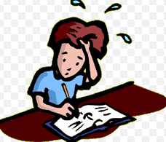
If you picked “often” or “very often”…..
4 or more times….

Slide 59

Physical Effects
of abusing drugs and
Alcohol

Slide 72

Physical dangers of drugs and alcohol

Slide 73
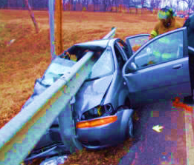
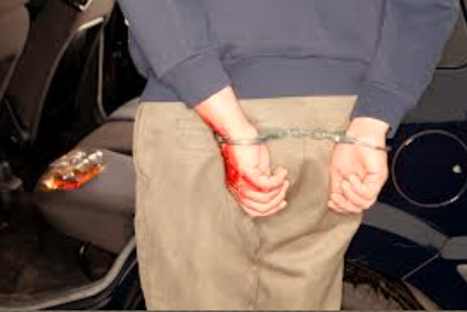
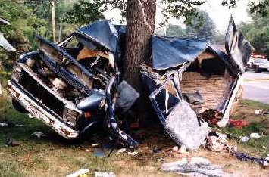
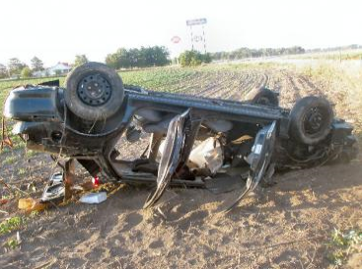

Slide 74
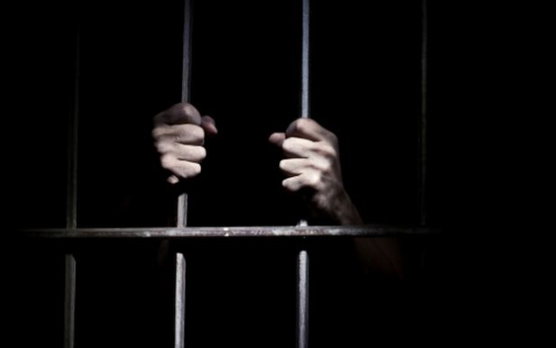
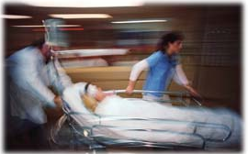
Notes:
4 people died in this vehicle

Slide 75
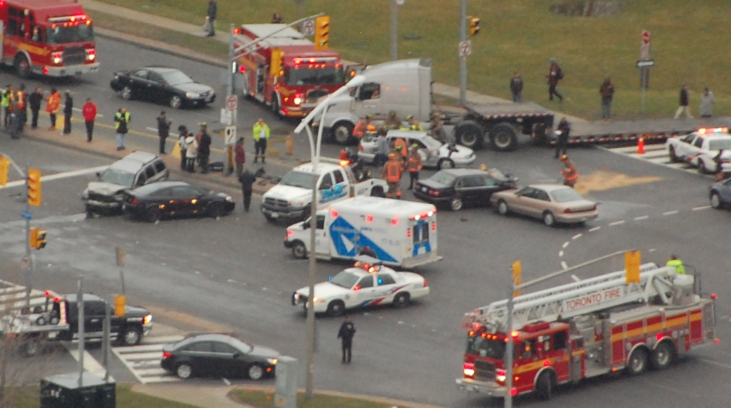
- April 14th, 2013
- Kennedy Road at the off-ramp from Highway 401's eastbound lanes
- Impaired driver: 1 cyclist killed, at least 4 injured, including infant

Slide 76
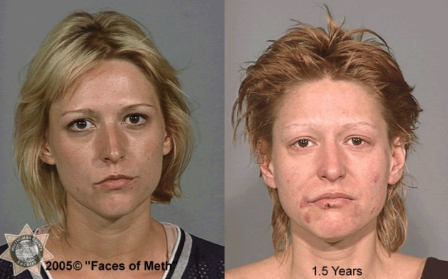
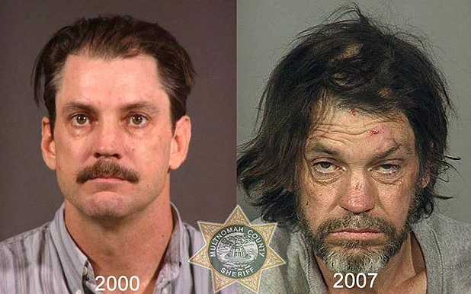

Slide 77
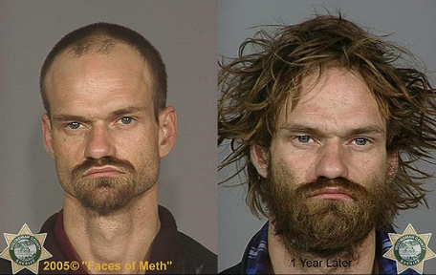
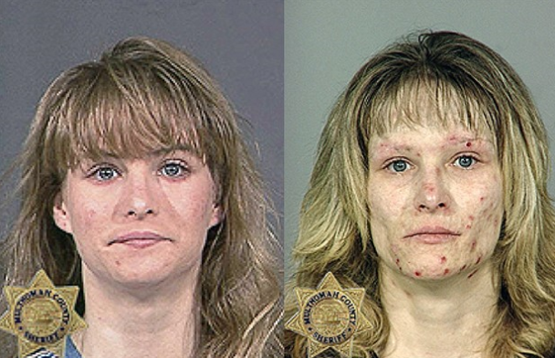
Notes:
I have noticed huge changes in people as they go through recovery

Slide 78
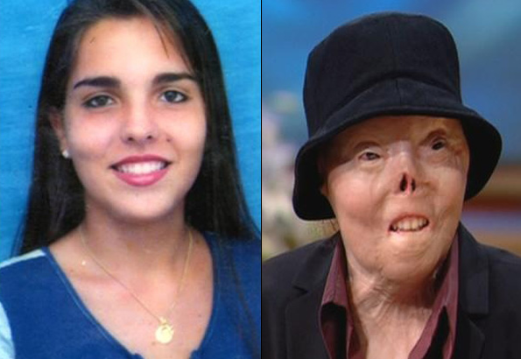
Jacqueline Saburido

Slide 79
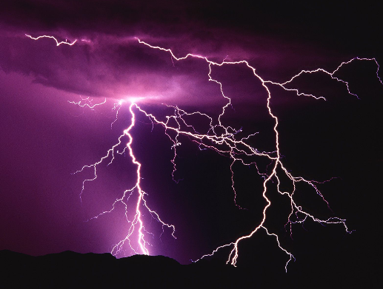
…there is more….

Slide 80


Slide 81

  Temporarily feel good
  Temporarily feel better
  Curious
  Peer pressure
  Anxiety/Worry
  Depression
  Hopelessness
  Loneliness
  New Experience
  Shared experience
  Boredom
  Self-pity
  Fear
  Confusion
  Sadness
  Isolation
  Humiliation
  Not feeling well (sick, tired, hungry, etc)
  Spiritually weak

Slide 82

  Temporarily feel good
  Temporarily feel better
  Curious
  Peer pressure
  Anxiety/Worry
  Depression
  Hopelessness
  Loneliness
  New Experience
  Shared experience
  Boredom
  Self-pity
  Fear
  Confusion
  Sadness
  Isolation
  Humiliation
  Not feeling well (sick, tired, hungry, etc)
  Spiritually weak
Are we there for each other, for our kids?

Slide 83
CAUSES
?
?
?
?
?
?

Slide 84
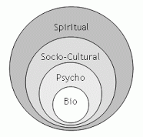
Biopsychosocialspiritual

Slide 85
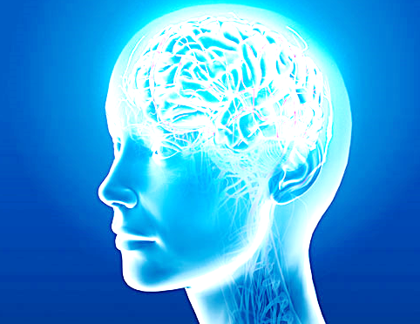
BIOpsychosocialspiritual

Slide 86



Slide 87

One
Trillion
Pennies

Slide 88

1 Quadrillion
Connections

Slide 90


Fine balance…

Slide 91


Slide 92

“Our actions influence connections”

Slide 93



“…that much
harder…”

Slide 94
BIOpsychosocialspiritual
Comorbidity

Slide 95

BioPSYCHOsocialspiritual

Slide 96
Social skills
Coping skills
Self worth
Temperament
Cognition
Emotions
Stress
Trauma
Self-efficacy

Slide 97
Social skills
Coping skills
Self worth
Temperament
Cognition
Emotions
Stress
Trauma
Self-efficacy

Slide 98
Social skills
Coping skills
Self worth
Temperament
Cognition
Emotions
Stress
Trauma
Self-efficacy

Slide 99
Social skills
Coping skills
Self worth
Temperament
Cognition
Emotions
Stress
Trauma
Self-efficacy

Slide 100
Social skills
Coping skills
Self worth
Temperament
Cognition
Emotions
Stress
Trauma
Self-efficacy

Slide 101
Social skills
Coping skills
Self worth
Temperament
Cognition
Emotions
Stress
Trauma
Self-efficacy

Slide 102
Social skills
Coping skills
Self worth
Temperament
Cognition
Emotions
Stress
Trauma
Self-efficacy

Slide 103
Social skills
Coping skills
Self worth
Temperament
Cognition
Emotions
Stress
Trauma
Self-efficacy

Slide 104
Social skills
Coping skills
Self worth
Temperament
Cognition
Emotions
Stress
Trauma
Self-efficacy

Slide 105
Social skills
Coping skills
Self worth
Temperament
Cognition
Emotions
Stress
Trauma
Self-efficacy

Slide 106
BioPSYCHOsocialspiritual
Social skills
Coping skills
Self worth
Temperament
Cognition
Emotions
Stress
Trauma
Self-efficacy

Slide 107

BiopsychoSOCIALspiritual

Slide 108
Peers
School
Work
Family circumstances
Church community
Free time

Slide 109
Peers
School
Work
Family circumstances
Church community
Free time

Slide 110
Peers
School
Work
Family circumstances
Church community
Free time

Slide 111
Peers
School
Work
Family circumstances
Church community
Free time

Slide 112
Peers
School
Work
Family circumstances
Church community
Free time

Slide 113
Peers
School
Work
Family circumstances
Church community
Free time

Slide 114
Peers
School
Work
Family circumstances
Church community
Free time

Slide 115
BiopsychoSOCIALspiritual
Peers
School
Work
Family circumstances
Church community
Free time

Slide 116

BiopsychosocialSPIRITUAL

Slide 117
Biblical Worldview
Whom do you serve?
Conversion experience
State of mind and heart
Spiritual maturity
Focus
Motivation
Role of Holy Spirit in our life
Faith

Slide 118
Biblical Worldview
Whom do you serve?
Conversion experience
State of mind and heart
Spiritual maturity
Focus
Motivation
Role of Holy Spirit in our life
Faith

Slide 119
Biblical Worldview
Whom do you serve?
Conversion experience
State of mind and heart
Spiritual maturity
Focus
Motivation
Role of Holy Spirit in our life
Faith

Slide 120
Biblical Worldview
Whom do you serve?
Conversion experience
State of mind and heart
Spiritual maturity
Focus
Motivation
Role of Holy Spirit in our life
Faith

Slide 121
Biblical Worldview
Whom do you serve?
Conversion experience
State of mind and heart
Spiritual maturity
Focus
Motivation
Role of Holy Spirit in our life
Faith

Slide 122
Biblical Worldview
Whom do you serve?
Conversion experience
State of mind and heart
Spiritual maturity
Focus
Motivation
Role of Holy Spirit in our life
Faith

Slide 123
Biblical Worldview
Whom do you serve?
Conversion experience
State of mind and heart
Spiritual maturity
Focus
Motivation
Role of Holy Spirit in our life
Faith

Slide 124
Biblical Worldview
Whom do you serve?
Conversion experience
State of mind and heart
Spiritual maturity
Focus
Motivation
Role of Holy Spirit in our life
Faith

Slide 125
Biblical Worldview
Whom do you serve?
Conversion experience
State of mind and heart
Spiritual maturity
Focus
Motivation
Role of Holy Spirit in our life
Faith

Slide 126
Biblical Worldview
Whom do you serve?
Conversion experience
State of mind and heart
Spiritual maturity
Focus
Motivation
Role of Holy Spirit in our life
Faith

Slide 127
BiopsychosocialSPIRITUAL
Biblical Worldview
Whom do you serve?
Conversion experience
State of mind and heart
Spiritual maturity
Focus
Motivation
Role of Holy Spirit in our life
Faith

Slide 128

Warning Signs….

Slide 129
Warning Signs….
Abuse of drugs /alcohol
Pornography
Blood shot eyes
Pupils larger or smaller than usual
Avoid eye contact
Change in appetite
Change in sleep patterns
Tremors, impaired coordination
Failure in school
Missing school
Missing work
Isolating, withdrawn

Slide 130
Warning Signs….
Hanging out with the wrong crowd
Stealing
Money issues
Acting secretively
Frequent physical complaints, such as headaches or stomach aches
Getting into trouble (fights, accidents)
Mood swings, irritable
Risk-taking behaviors
Depression or suicidal thoughts or behavior
Anxious, Paranoid for no real reason
Lack of motivation

Slide 131
Awareness and Prevention
vs
Recovery

Slide 132
…It gets worse….

Slide 133

Bondage

Slide 159
Proverbs 14:12
“There is a way which seemeth right unto
a man, but the end thereof are the ways
of death.”
“Help me…”

Slide 160

From Bondage to Freedom

Slide 161
Psalm 51:10
Create in me a clean heart, O God; and renew a right spirit within me.

Slide 183
Condition of our heart…
Psalm 51: 10
“Create in me a clean heart, O God; and renew a right spirit within me.”

Slide 184
Matthew 7:7
Ask, and it shall be given you; seek, and ye shall find; knock, and it shall be opened unto you.
Proverbs 3:5-6
Trust in the Lord with all thine heart; and lean not unto thine own understanding; In all thy ways, acknowledge him, and he shall direct thy paths.

Slide 185
Focus: Prevention
Addiction…? Who…me?
Definition of addiction
Biblical view of addiction
Types of addiction
“Testing…”
Physical effects on our body
Physical dangers
Why we use
What causes addiction?:
  Bio-psycho-social-spiritual
Warning signs
What bondage looks like
What freedom looks like

Slide 186
Prevention
“House Rules”
1. We obey our Lord Jesus Christ
2. We love, honor and pray for one another
3. We tell the truth
4. We consider one another’s interests ahead of our own
5. We speak quietly and respectfully
6. We do not hurt one another with unkind words or deeds
7. When someone needs correction, we correct him in love
8. When someone is sorry, we forgive him
9. When someone is sad, we comfort him
10. When someone is hurting, we help them
11. When someone is happy, we rejoice with him
12. When we have something nice to share, we share it

Slide 187
Prevention
HEALTHY HOME/CHURCH FAMILIES
1. A healthy family communicates honestly, directly and thoughtfully.
2. A healthy family supports and affirms one another.
3. A healthy family maintains trust through reliability and consistency.
4. A healthy family practices respect for each other and for others.
5. A healthy family shares a sense of order and responsibilities.
6. A healthy family shares leisure time and a positive sense of humor.
7. A healthy family teaches traditions, values and right from wrong.
8. A healthy family shares attention among members in a balanced way.
9. A healthy family respects appropriate boundaries among each other.
10. A healthy family values service to others.
11. A healthy family is flexible under stress.
12. A healthy family resolves disagreements without damaging words.
13. A healthy family admits problems and seeks help from others.
14. A healthy family shares a sense of optimism for the future.

Slide 188
John 10: 10
“…I am come that they might have life, and that they might have it more abundantly.”

Slide 189

References upon request

Slide 190
Website: acncounseling.org
Thank you for your attention!

